Slide 1
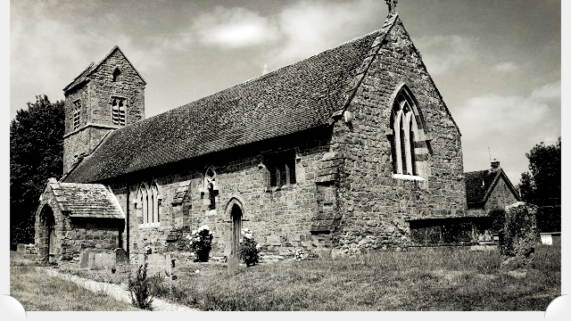
Claydon & Clattercote PC
Vision & Strategic Plan 2023 – 2030

Slide 2
The Village Vision
What follows is a selection of ideas put forward by Parishioners at various meetings and venues.
The proposals are NOT set in stone but have been carefully looked at and investigated by the PC to fit the Village Mission Statement & Vision criteria as detailed on the next slide.
All the proposals are viable, especially with additional proposed HS2 funding currently available to us this year, which the PC are investigating.
The proposed facilities are intended to ‘Open Up’ the Playing Field to the community and encourage its more effective use.
There is an accompanying brief questionnaire that we encourage you to download, fill in and return to the PC asap so we can start to plan forwards.
Time, as always, is of the essence.
Thank You

Slide 3
Mission Statement
The Parish Council Vision
Community Support our local communities, encourage inclusion and diversity
Environment Protect and enhance our local environment
Governance Promote participation, good management and efficiency
To maintain and enhance the quality of life and sense of community within the Parish of Claydon & Clattercote.
To safeguard the individual character of our village and protect its rural environment whilst supporting sustainable development that meets the needs of residents now and in the future.

Slide 4
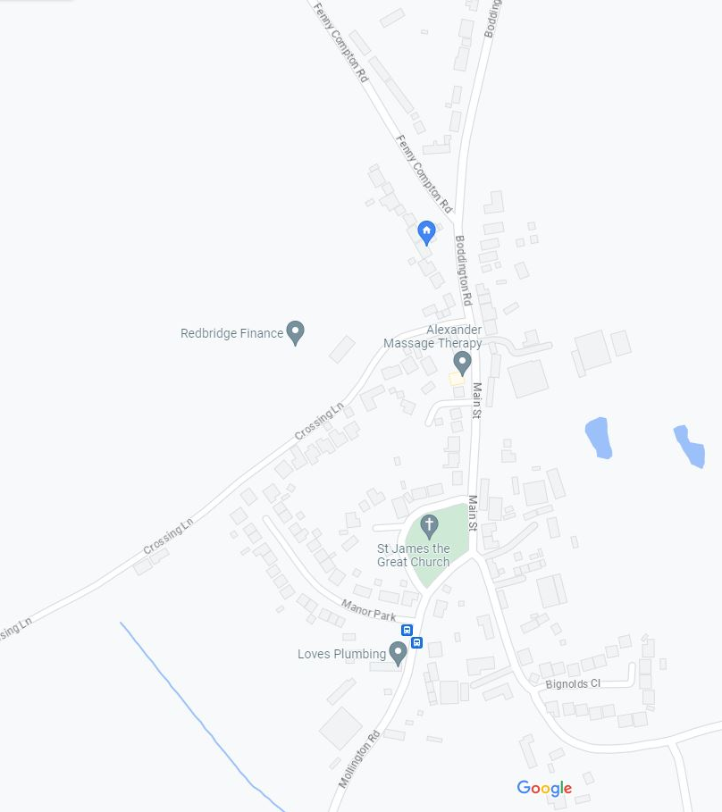
Village Layout
Overhead view of the Village area.
Currently comprises of:
4 main road entry points
Fenny Compton Rd
Boddington Rd
Mollington Rd
Main St (leads to Cropredy)
Village Green
Church & Church Room
Pathway (Blue Brick)
VG

Slide 5
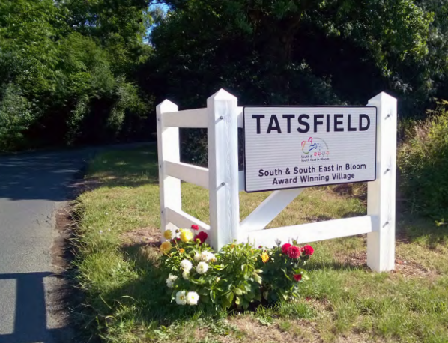
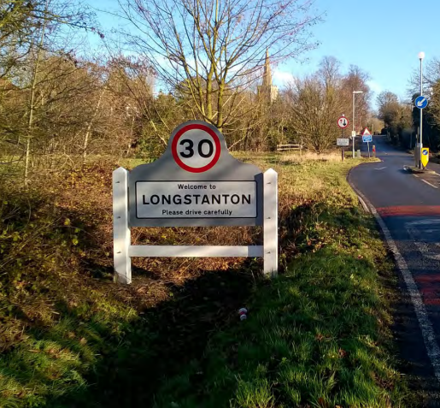
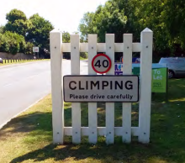
Enhancement ideas for the Village
These items would not need serious funding:
1. Traffic Gateways to the Village
- Welcoming signs into the village.
- Potentially slows approaching traffic down on entering.
PC-CDC funding\External Funding
2. Extra Benches
- Add a few more benches around the village.
- Serve as resting points for the less abled or just to admire the view.
PC funding\External Funding
3. Bulbs and Wildflower planting
Adds colour.
PC funding

Slide 6
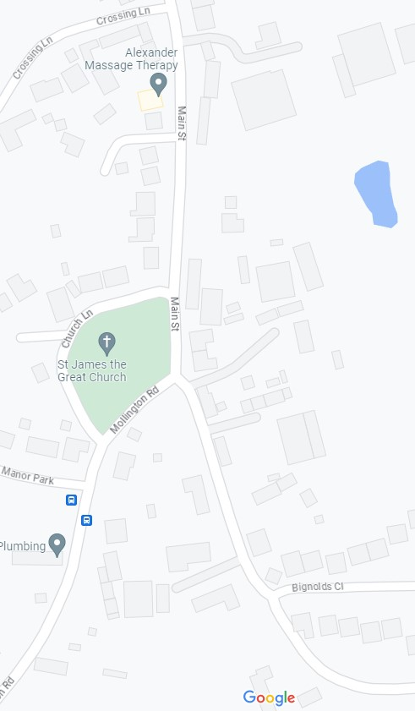
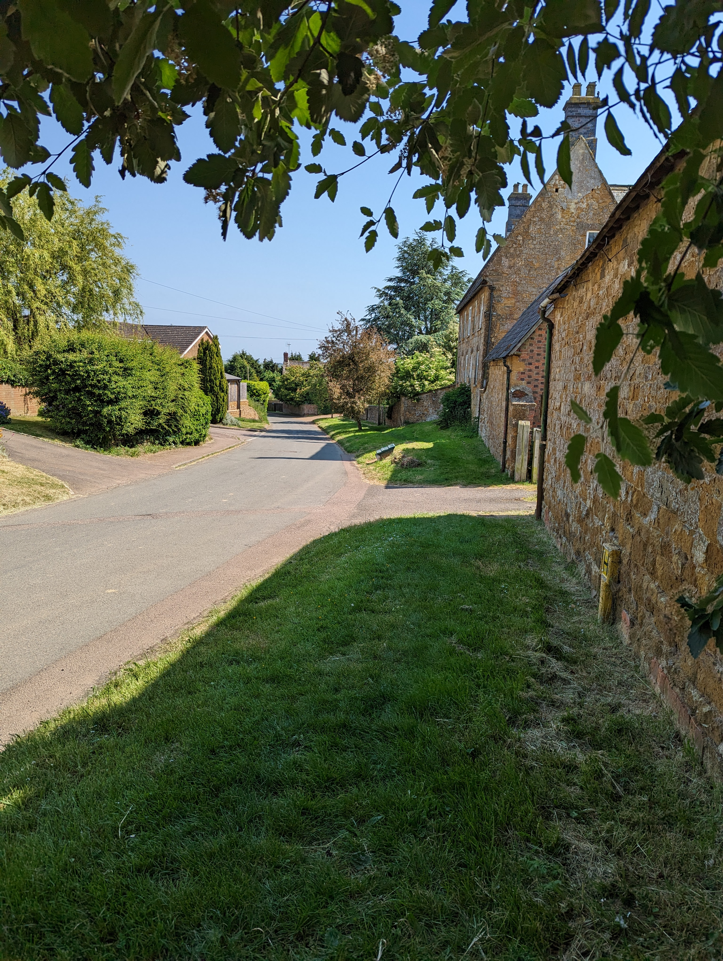
Blue Brick Pathway extension
This item would potentially need some funding:
Cllr Mark has been in contact with Nick Watson regarding this situation:
Extending the footpath from Dog Lane, round the corner
The path currently ends at the entrance to dog lane, this then turns into a grass embankment that runs to the driveway of Clattercote House. The path then runs to the dropped kerb.
Request for the council to install a footpath along the embankment joining up with the tarmacked path near Clattercote house then to reinstate the pathway across the drive to the small industrial unit on the corner.
Rationale: the lack of path is currently dangerous as it forces pedestrians to walk in the road. Elderly infirm and parents with buggies and young children have to walk in the road on the approach to a blind bend and round it.
Discussion / Action : Nick explained that he will add this to the County Council list of works but we should not hold our breath. Nick will provide indicative cost of this work to me as we can use this in our business case for HS2 funding and hopefully release the burden on OCC.

Slide 7
Approx. Costs for items
Traffic Gateways: £200 - £450 per item depending on what style is chosen.
Benches: approx. £520 each
Bulbs\Wild flowering: approx. £100 for a big mixed box of woodland bulbs (250, 4 varieties).
Pathway Extension:

Slide 8
Additional Information
For additional information regarding a full slide presentation pack and brief questionnaire, please email the below address stating in the subject line:
‘Village Vision Request’.
cwcclerk@outlook.com
Thank you

