Slide 1
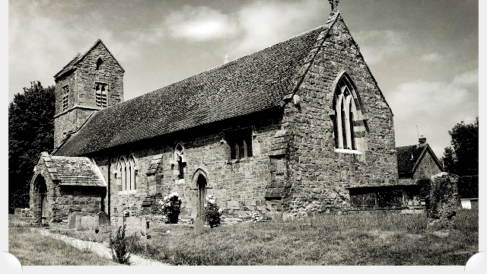
Claydon & Clattercote PC
Vision & Strategic Plan 2023 – 2030

Slide 2
The Playing Field Vision
What follows is a selection of ideas put forward by Parishioners at various meetings and venues.
The proposals are NOT set in stone but have been carefully looked at and investigated by the PC to fit the Village Mission Statement & Vision criteria as detailed on the next slide.
All the proposals are viable, especially with additional proposed HS2 funding currently available to us this year, which the PC are investigating.
The proposed facilities are intended to ‘Open Up’ the Playing Field to the community and encourage its more effective use.
There is an accompanying brief questionnaire that we encourage you to download, fill in and return to the PC asap so we can start to plan forwards.
Time, as always, is of the essence.
Thank You

Slide 3
Mission Statement
The Parish Council Vision
Community Support our local communities, encourage inclusion and diversity
Environment Protect and enhance our local environment
Governance Promote participation, good management and efficiency
To maintain and enhance the quality of life and sense of community within the Parish of Claydon & Clattercote.
To safeguard the individual character of our village and protect its rural environment whilst supporting sustainable development that meets the needs of residents now and in the future.

Slide 4
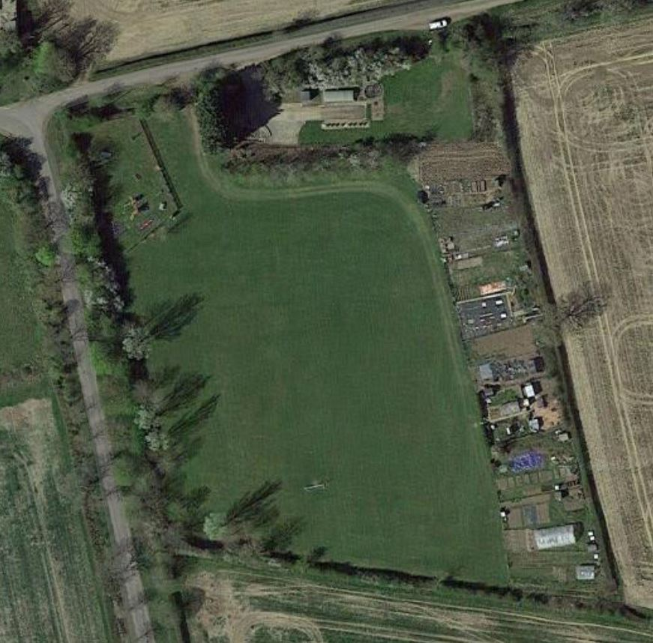
Playing Field
Overhead view of the Playing Field area.
Currently comprises of:
Play area for children
Allotments
Storage Container
Goal Posts (1 set)
A couple of benches\picnic tables
A few trees

Slide 5
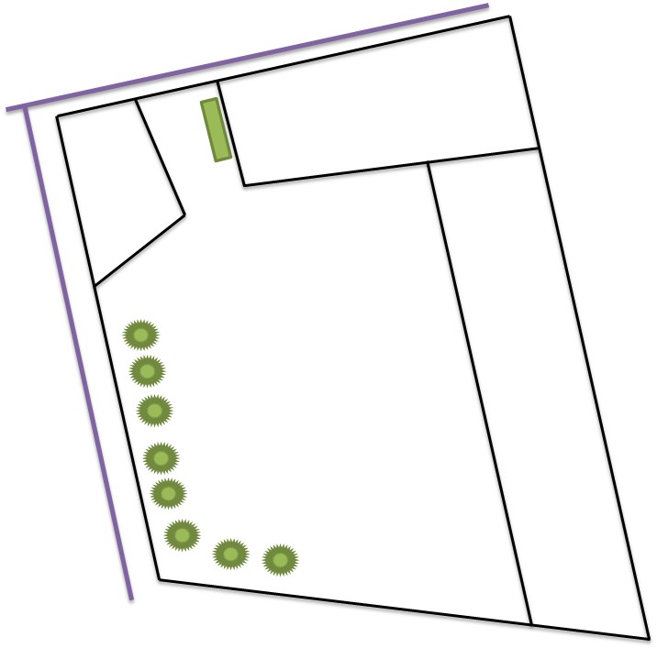
Playing Field Vision
Storage Container
Water Works
Childrens Park
Proposal
1. Toilet\Cafe Serving Facility
- Wooden clad container
2. More Picnic Tables\Benches
3. Firepit\BBQ Area
4. Extend Tree Line
5. Pathway
6. MUGA Court (Multi Use Games Area)
- All weather artificial pitch\court for Badminton \ Volleyball \ Football \ Basketball \ Hockey \ Skittles
WC\Café Area
Picnic Tables\Benches
Fire Pit BBQ Area
Allotments
Picnic Tables
MUGA
Viewing Platform?
Extend Tree Line

Slide 6
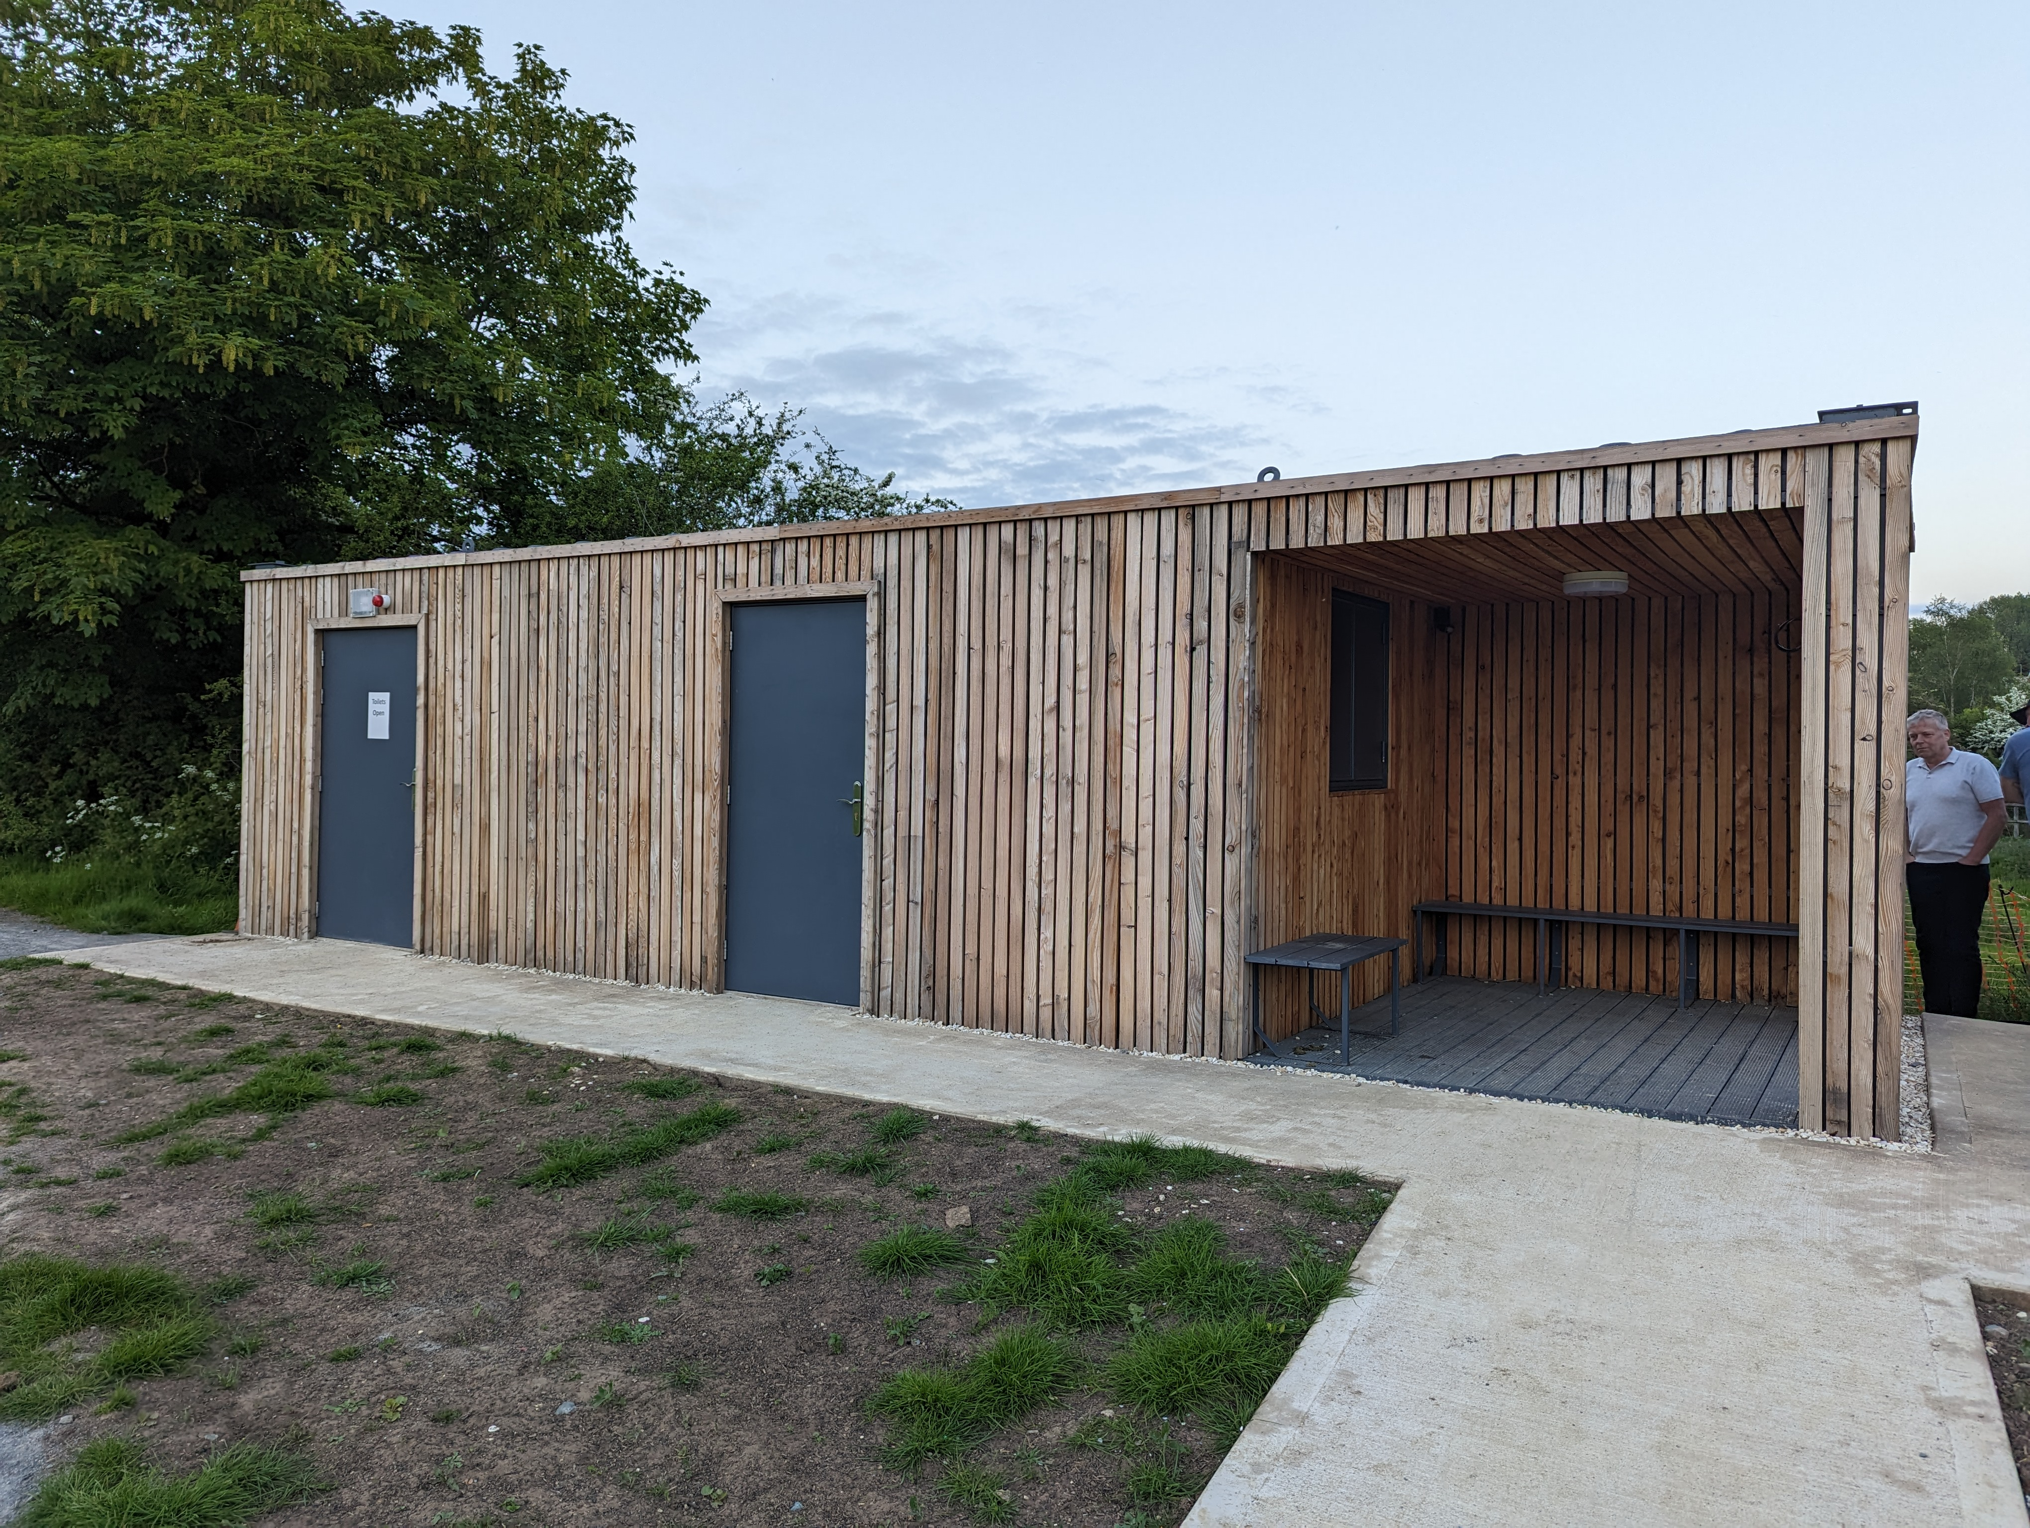
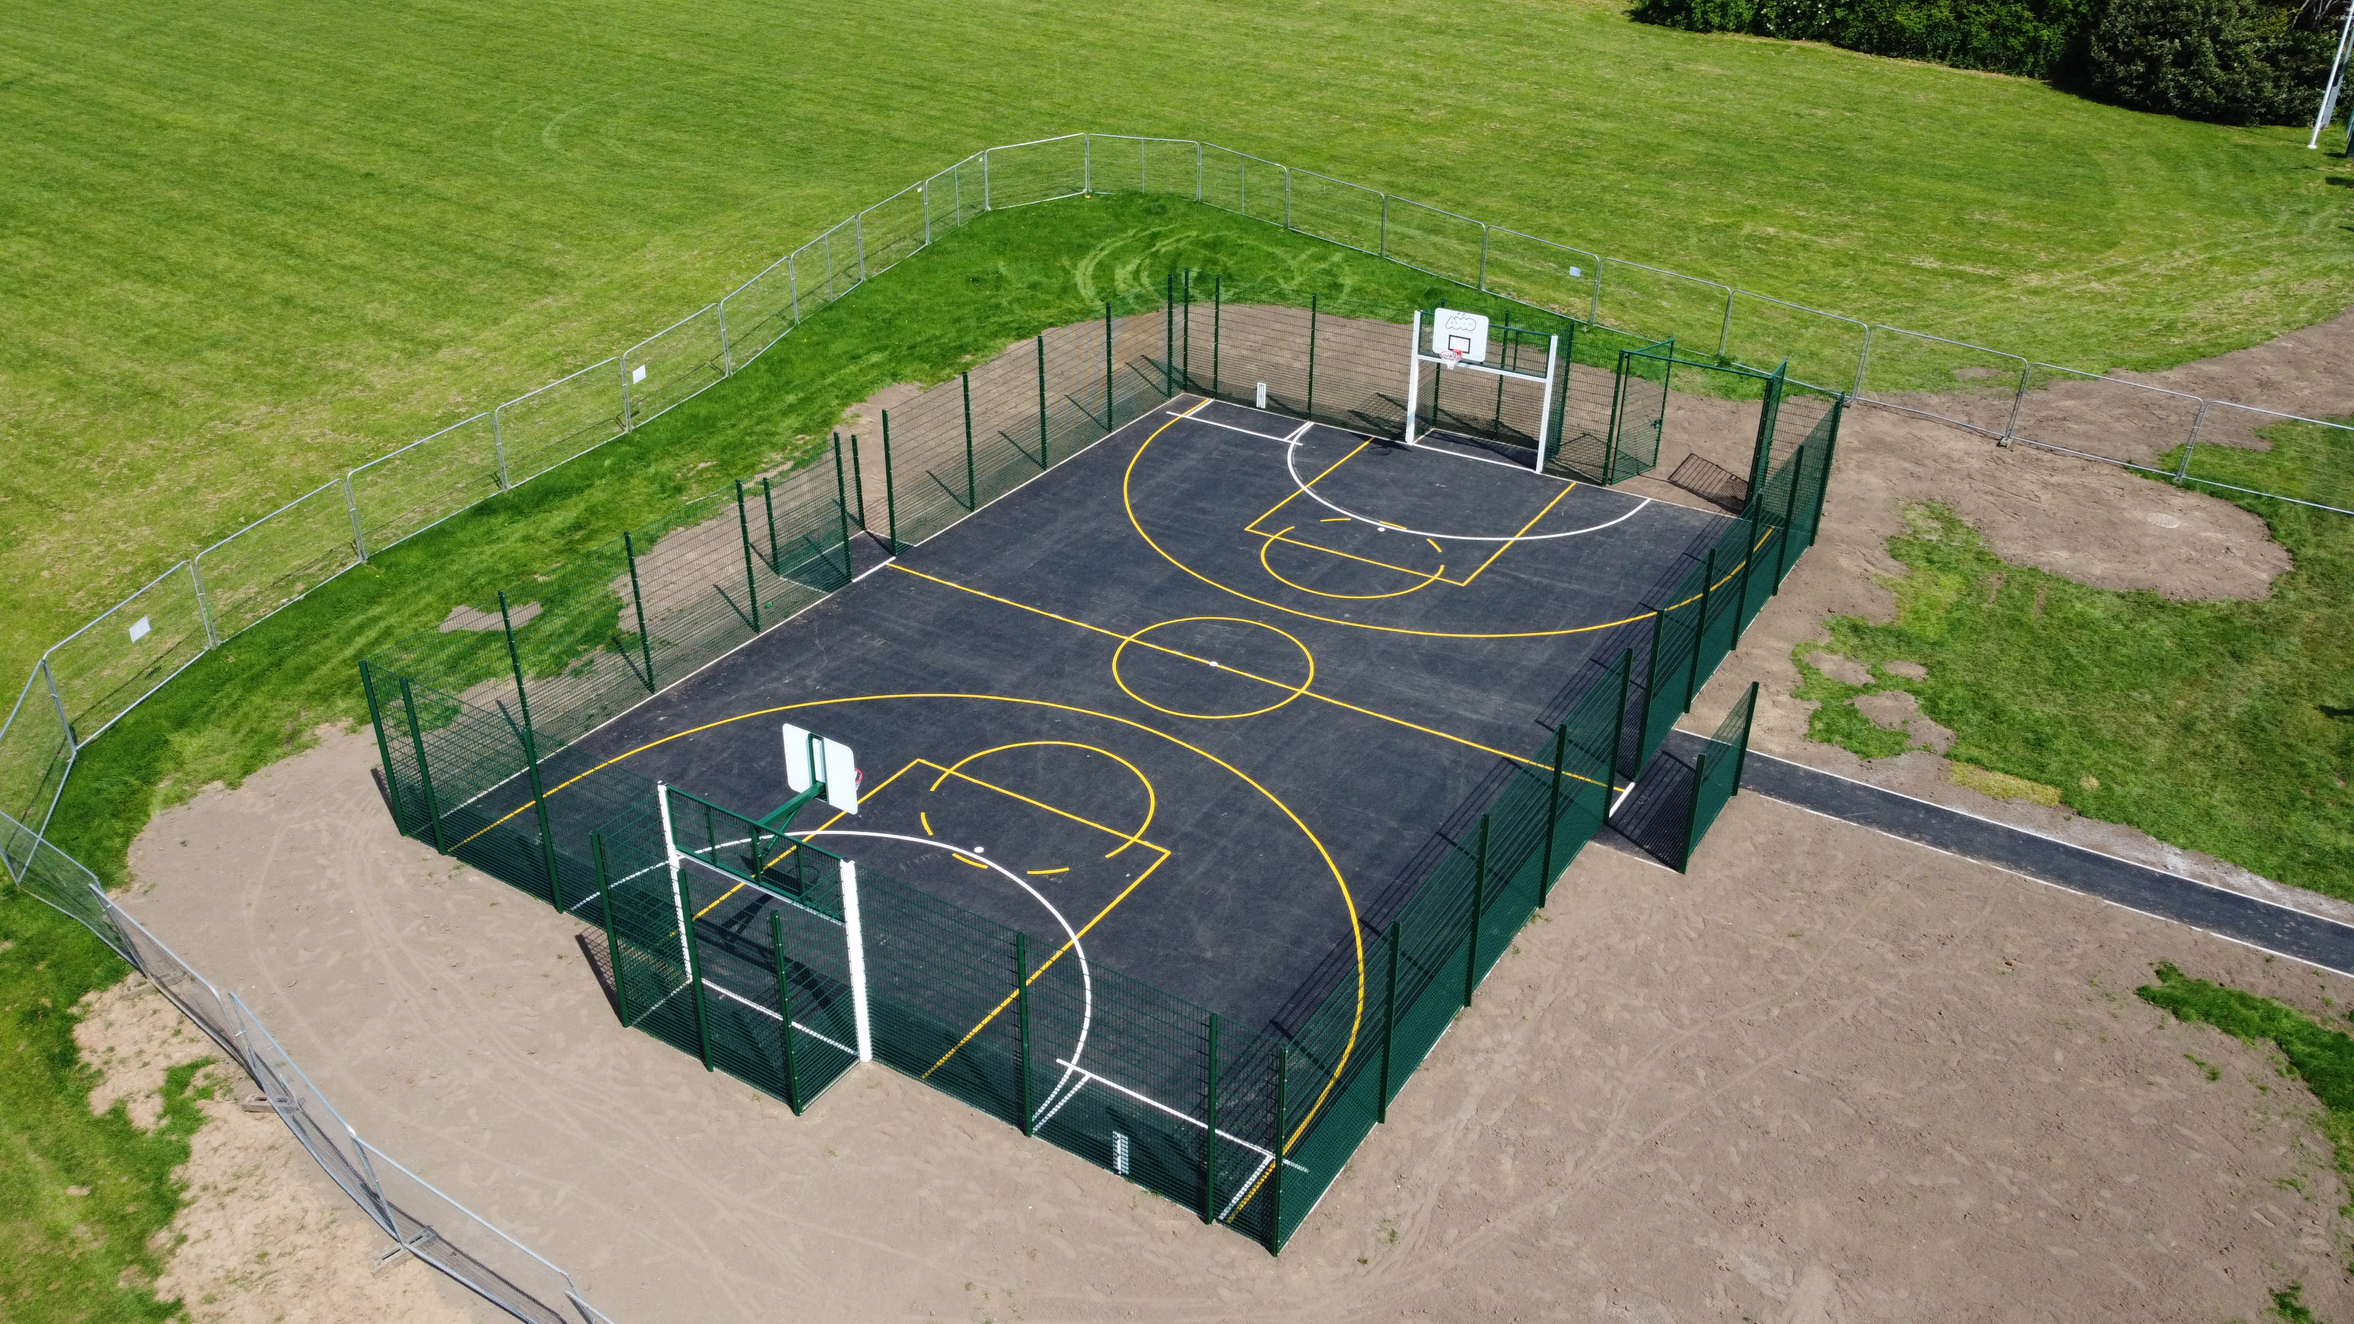
High Price Ticket Items
These items would need serious funding:
1. Toilet\Cafe Facility
- Toilet with disabled facilities.
- Mini Kitchen for drinks and basic foods and a serving hatch
- Water point for allotments
HS2 Funding
2. MUGA
- Multipurpose all-weather playing court. This is to give you an idea of a MUGA court, we would be looking at a smaller version. See alternative images later in pack.
HS2 funding
In case of the Toilet\Serving container, additional funds would be needed for:
Electrical wiring and Grid connection.
Plumbing for fresh and wastewater.
Plumbing for Toilet – direct to sewer main OR septic tank arrangement.
Ground preparation.

Slide 7
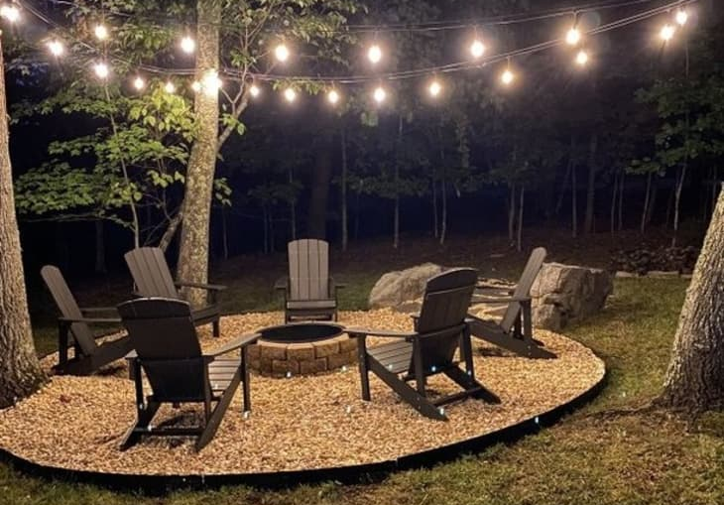
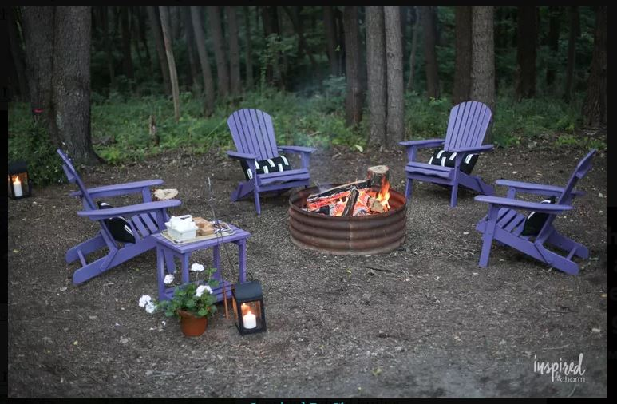
Mid-Range Price Ticket Item
These items would need some funding:
Fire Pit\BBQ Area
- Encourage more social use of the Playing Field
- Health and Safety: provide a dedicated, carefully chosen and prepared area to minimize risks of fire of BBQs.
Funds would be needed for:
Material Sourcing.
Solar Lights.
Ground preparation.
Construction.
Pathway
- Encourage more social use of the Playing Field esp. for disabled people.
Cinder track, tarmac or rugged plastic matting.

Slide 8
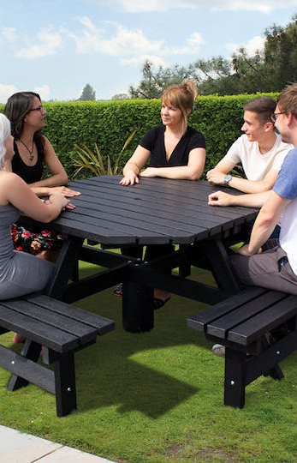
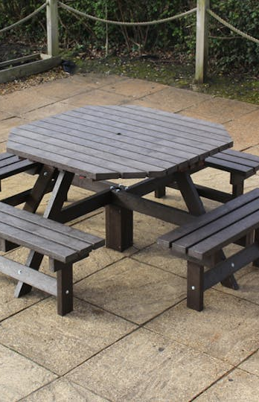
Low Price Ticket Items
These items could be provided by the PC:
1. Additional Picnic Tables\Benches
- Encourage more social use of the Playing Field
2. Additional Trees
- Help protect the area from the wind and create a more enclosed\cozy environment.
Funds would be needed for:
Tree saplings.
Picnic Tables\Benches.
Ground preparation.

Slide 9
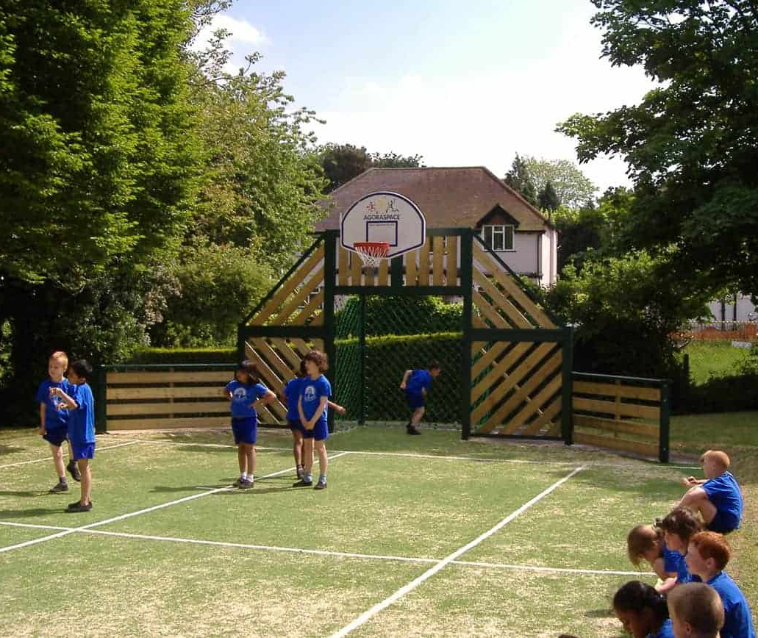
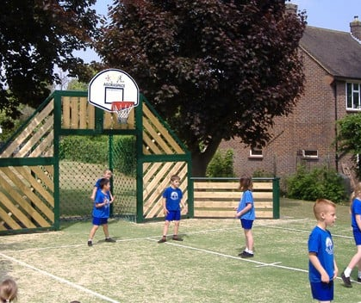
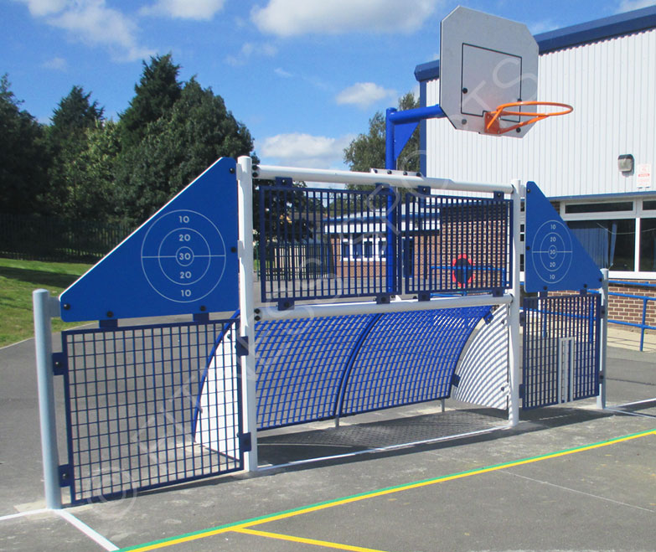
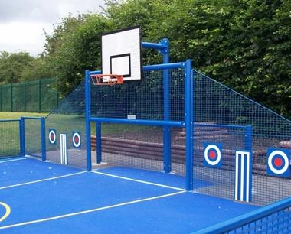
Alternative MUGA images

Slide 10
Approx. Costs for big ticket items
WC/Café (container): £25k plus connection charges (water & electricity), surveys, ground prep & septic tank: £35k
MUGA – 15m x 8m (badminton court size): includes equipment, survey, groundworks and spoil removal: £30k - £35k.
There will be a full survey and quote available from end of September ‘23.

Slide 11
Additional Information
For additional information regarding a full slide presentation pack and brief questionnaire, please email the below address stating in the subject line:
‘Playing Field Vision Request’.
cwcclerk@outlook.com
Thank you

Slide 12
Survey Results…so far
The WC\Cafe seems to the most popular project and highest ranked in importance. Parishioners realise this will really ‘open up’ the field.
This followed by need for a few more Picnic tables. Which again makes sense if you have the ‘facilities’ on hand to enjoy and use them.
While the Pathway and MUGA court come in close behind. Again, this makes sense if you have the facilities and the means to access them.
It also helps us with the HS2 funding idea as the big ‘3’; WC\Cafe, MUGA court and Pathway, being adapted to this. I will see if the Pathway can be created at the same time as the MUGA court by the same company – economy of scale…

